Slide 1


Founding the Future:
The SNU Global Innovation Hub
Establishing a Permanent Legacy in the United States (2026–2028)
Strategic Partnership: SNU & SNUAA USA
Presenter: SNUAA USA Campaign Committee
Veritas Lux Mea – Shining Globally

Slide 2

PART I: THE VISION
Elevating SNU to a Top 10 Global University

Slide 3
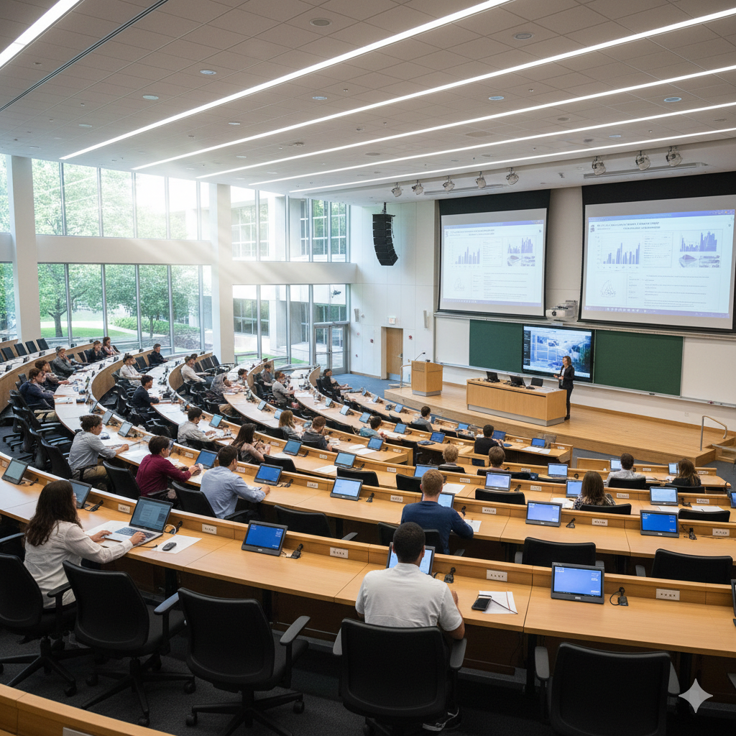

THE "WHY" – SNU’S GLOBAL MANDATE
The 3G Initiative
President Ryu Hong-lim’s vision for Global Network, Leadership, & Engagement requires a physical presence in the world’s most influential ecosystem.
•
Accelerator: Launchpad for researchers & startups.
•
Education: U.S. base for "SNU in the World".
•
Collaboration: R&D bridge with top U.S. institutions.

Slide 4




THE "WHY" – GLOBAL COMPETITION
Country | University | US Hub
Korea | KAIST | Silicon Valley IDIS Campus
China | Tsinghua Univ | Seattle Global Innovation Exchange (GIX)
Japan | Tokyo U / Kyoto U / Waseda U | New York / Washington, DC / San Francisco
Singapore | NUS | Chicago / New York / Silicon Valley / Greater Bay Area

Slide 5




Key Activity Pillars
Entrepreneurship
Facilitating "Silicon Valley immersions" for students and providing incubators for alumni-led startups.
Alumni Relations
Maintaining "Alumni Houses" that serve as networking hubs for the hundreds of thousands of Asian graduates living in the U.S.
Research Partnerships
Coordinating joint research labs with elite U.S. institutions (e.g., the GIX institute or bio-tech collaborations).
Global Recruiting
Marketing degree programs to American students and international students residing in the U.S.

Slide 6
A DUAL-PURPOSE FACILITY
For the University (The Hub) | For the Alumni (The Home)
Startup Accelerator Co-working spaces & VC access for SNU founders and entrepreneurs. | Executive Networking High-profile event spaces designed for professional growth and galas.
Global Classroom Instructional space for visiting students, faculty, and research exchange. | Mentorship Center A dedicated space for "Sunbae" to guide "Hobae" navigating the U.S. market.
Corporate Relations A front-door portal for U.S. corporate partnerships and R&D collaboration. | Legacy Wall P ermanent physical recognition of alumni success and global philanthropy.

Slide 7




STRATEGIC HEART: WHY LOS ANGELES?
Alumni Density
Over 40% of SNUAA USA members reside in Southern California, creating a massive local support system.
Cultural & Economic Synergy
Gateway for K-Culture and proximity to Silicon Beach, Aerospace, and Fintech hubs.
The Hub as a "Home"
A physical headquarters for SNUAA USA activities, mentoring, and professional networking.

Slide 8

PART II: THE ACTION PLAN
From Strategic Vision to Permanent Reality

Slide 9
FINANCIAL ROADMAP: $15M OVER 24 MONTHS
Phase I: 2026
Phase II: 2026
Phase III: 2027
2028 Opening
Leadership Giving
Quiet phase to secure 50% of funds from visionary donors.
Public Launch
Regional roadshows and site selection in Los Angeles.
Renovation
Finalizing technology integration and interior outfitting.
Grand Opening
Celebrating the SNU 82nd Anniversary in the U.S.

Slide 10
CAMPAIGN MILESTONES & STRATEGY
Leadership Quiet Phase (Current) Targeting major visionary donors to establish a solid financial foundation before public announcement.
Public Launch & Roadshows (Mid-2026) Mobilizing regional chapters across the USA for community-wide participation and awareness.
Site Selection & Design (2027) Securing the physical location and finalizing naming rights for key facility features.
Grand Inauguration (2028) The symbolic anchor for SNU's global future, timed with the University's 82nd year.

Slide 11
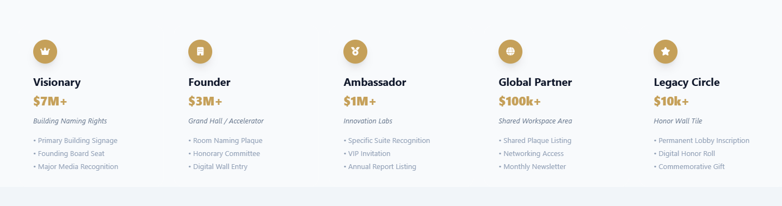
NAMING & RECOGNITION TIERS

Slide 12

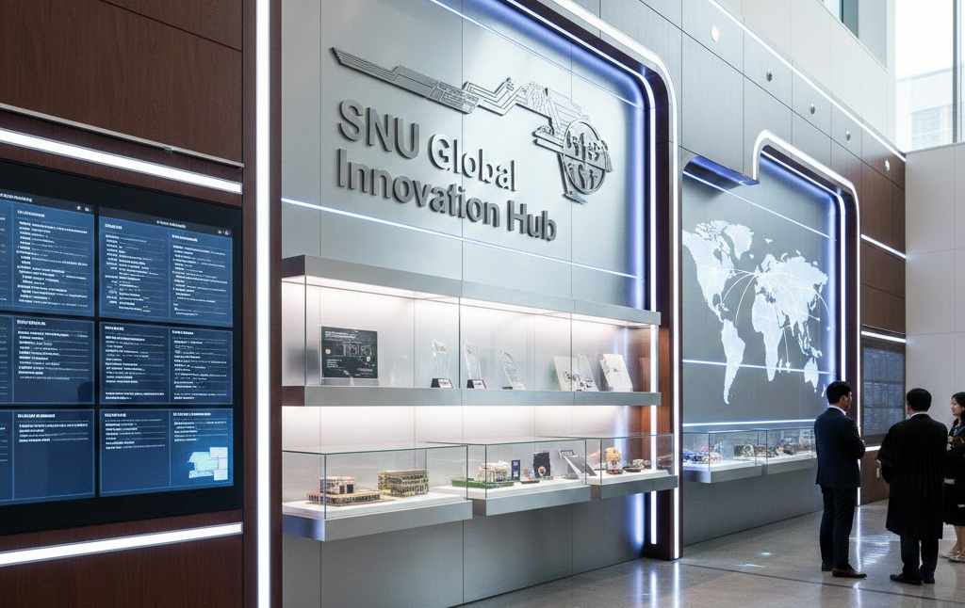

RECOGNITION & PHYSICAL PRESENCE
Innovation Labs
The Legacy Wall
Naming rights for the physical spaces where future SNU founders build the next unicorn startups.
A high-tech digital and physical honor roll for grassroots supporters and lifelong alumni donors.

Slide 13

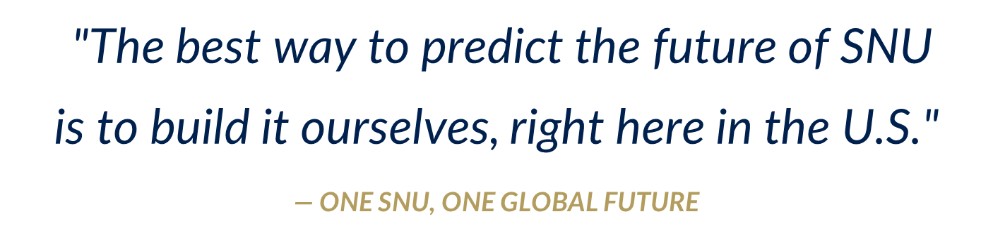

Slide 14


Q&A
Thank you very much for your concern and Participation.
SNUAA USA Campaign Committee
www.snuaa.org | contact@snuaa.org

Slide 15

Next Steps
Seeking 100% Board Participation to kick off the Leadership Phase.
1. Approve the Campaign Committee
2. Begin Prospect Outreach Strategy
3. Schedule Regional Chapter Roadshows
SNUAA USA Board of Directors Meeting | 2026–2028 Strategic Plan

